Slide 1








REEL‘EM IN
what makes a good call?

Slide 2



MISSION STATEMENT:
Our mission is to create authentic connections and build meaningful relationships with prospective residents. We believe in the power of kindness, attentiveness, and genuine care, drawing inspiration from the principles of The Fish Philosophy. By embracing an enthusiastic and positive approach to every conversation, we aim to make prospective residents feel welcome, valued, and heard. We are committed to creating a friendly, supportive environment where each interaction fosters trust and mutual respect, paving the way for future happy residents who feel at home and excited about their new community. Together, we make friends, build lasting relationships, and help others find a place where they truly belong.

Slide 3

ARE YOU READY TO PLAY?
BINGO!

Slide 4




https://www.youtube.com/watch?v=5mKfo4CYsI8

Slide 5



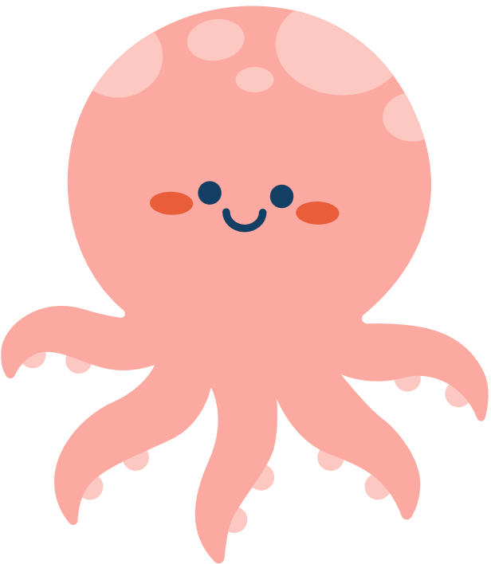

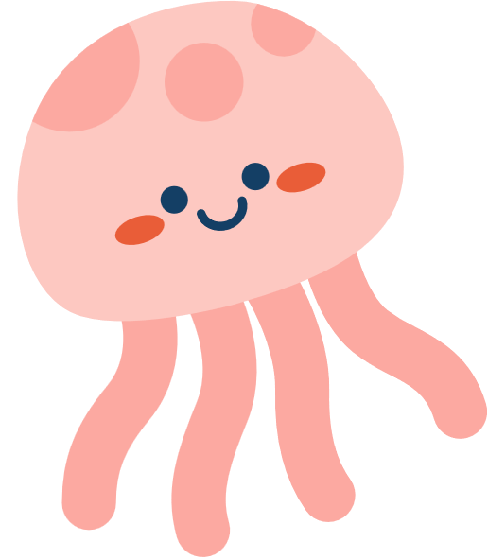

Let’s Listen to a Call!

Slide 6
What can make a call go bad?!
How do we get off on the wrong tone and how do prospects potentially start off with a “wrong” tone?

Slide 7
LET’S ROLE PLAY!

Slide 8
FISH! And our leasing presentations
How can we incorporate the four FISH! Philosophies into our calls and leasing presentations?
1
Choose Your Attitude
2
Play
3
Make Their Day
4
Be There

Slide 9
Let’s Listen to Another Call!

Slide 10
What makes a good call?
How do we make a friend?

Slide 11
LET’S ROLE PLAY!

Slide 12
https://www.tiktok.com/@claytonfarris4ever/video/7292837268765658411

Slide 13
CONCLUSION
Thank you everyone for sharing your thoughts today. We hope this roundtable gave you a better idea of what a successful call should sound like. The main goal is always to build a connection and to make a friend. This can done by asking open-ended questions and active listening. We hope you leave with some fresh ideas to apply moving forward.

